Slide 1
Create Model Classes
Introduction to JPA & Hibernate
Create a Model Class Manually
Generate Model Classes using Hibernate Reverse Engineering Tool
Model Classes: Users, Category, Book, Customer, Review, BookOrder and OrderDetail

Slide 2
Java Persistence API (JPA)
JPA is a Java API specification for relational data management in applications using Java SE and Java EE.
Version used: JPA 2.1
API Package:
javax.persistence
Java Persistence Query Language (JPQL)
Implementations: Hibernate, EclipseLink, OpenJPA…

Slide 3
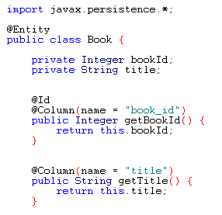
JPA Examples
Query:
SELECT b FROM Book b ORDER BY b.title

Slide 4
Hibernate Framework
Hibernate is a Object-Relational Mapping Framework
Hibernate is an implementation (or provider) of JPA
Hibernate ORM: Core
Domain model persistence for relational databases
Hibernate Search:
full-text search for domain model
Hibernate Validator:
constraints for domain model
Hibernate OGM:
domain model persistence for NoSQL databases
Hibernate Tools:
Plugins for Eclipse: Mapping Editor, Console, Reverse Engineering, …

Slide 5
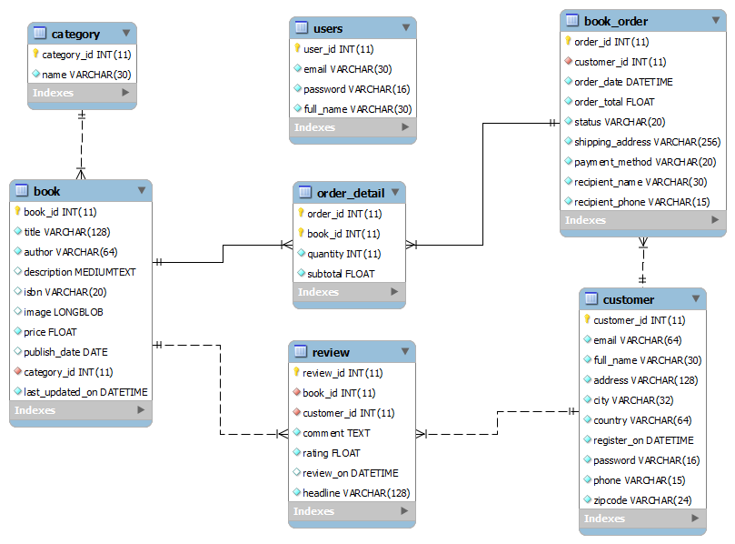
Entity Relationship Diagram

Slide 6
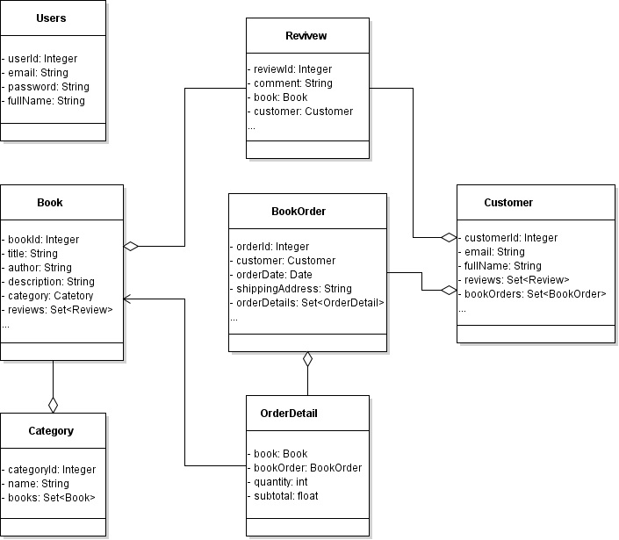
Model Class Diagram

Slide 7
Create a Model Class Manually
Create a POJO class: Users.java
Using JPA Annotations
Create JPA Config File: persistence.xml
Code a Test Program

Slide 8
JPA’s Annotations
@Entity
@Table
@Column
@Id
@GeneratedValue

Slide 9
JPA’s Configuration File
Create persistence.xml under META-INF in the source folder
Persistence Unit Name: BookstoreWebiste
Database Connection Properties:
JDBC URL
User
Password
JDBC Driver

Slide 10
EntityManager and EntityManagerFactory
EntityManager:
Is used to interact with the persistence context (the database)
A persistence context is a set of entity instances (objects of the model classes)
Manage entity instances and their lifecycle
Create, Remove, Find, Query Entities
EntityManagerFactory:
Creates an EntityManager
Associates with a persistence unit

Slide 11
Code a Test Program
Create an EntityManagerFactory
Create an EntityManager
Begin a transaction
Persist a Users object
Commit the transaction
Close the EntityManager
Close the EntityManagerFactory
Verify Result using MySQL Command Line Client

Slide 12
Generate Code for Model Classes using Hibernate Reverse Engineering
Install Hibernate Tools in Eclipse
Generate Code for Model Classes
Test the Generated Code

